Slide 1

Building a Successful C2C E-commerce Platform
Ishrak Alam
2211248
MIS465 SECTION:2
Submitted To: Arifur Rahman Khan

Slide 2


Bikroy Membership: Empowering Businesses Online
Virtual shop accessible to thousands of buyers.
Three membership tiers: Member, Verified Seller, Authorized Dealer.
Benefits: Increased ads, trust-building badges, free promotions, and ad reposting.
Features: Track buyer interest, doorstep delivery, dedicated support.

Slide 3

Web Usability Guidelines for C2C Platforms
Simple onboarding process with clear instructions.
User-friendly navigation with powerful search.
Trust-building features like verified profiles and ratings.
Mobile optimization for better accessibility.
Secure payment options ensuring privacy.

Slide 4
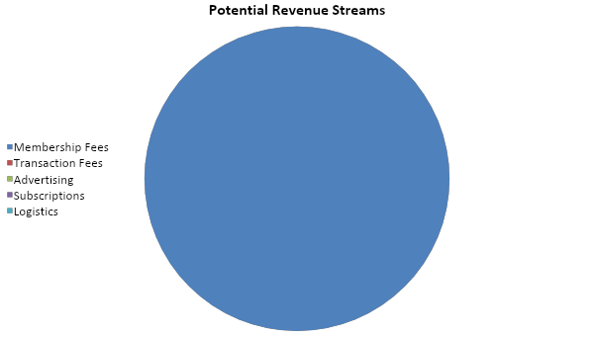
Revenue Model for C2C Businesses
Revenue Distribution
Membership fees for sellers with premium benefits.
Transaction fees on successful sales.
Advertising services for featured listings.
Subscription plans for analytics and automation.
Partnership with logistics for delivery commissions.

Slide 5

Thank You

